Slide 1
Big Data Engineering
Ganesh. R Senior Data Engineer

Slide 2
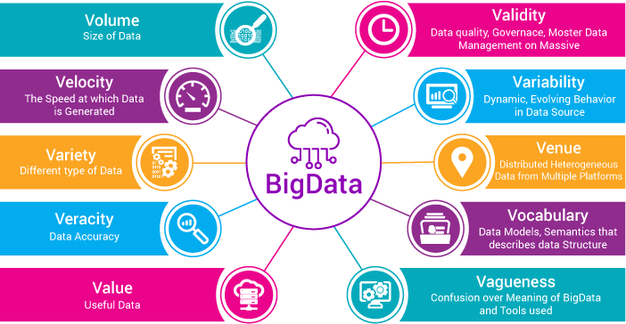

Slide 3
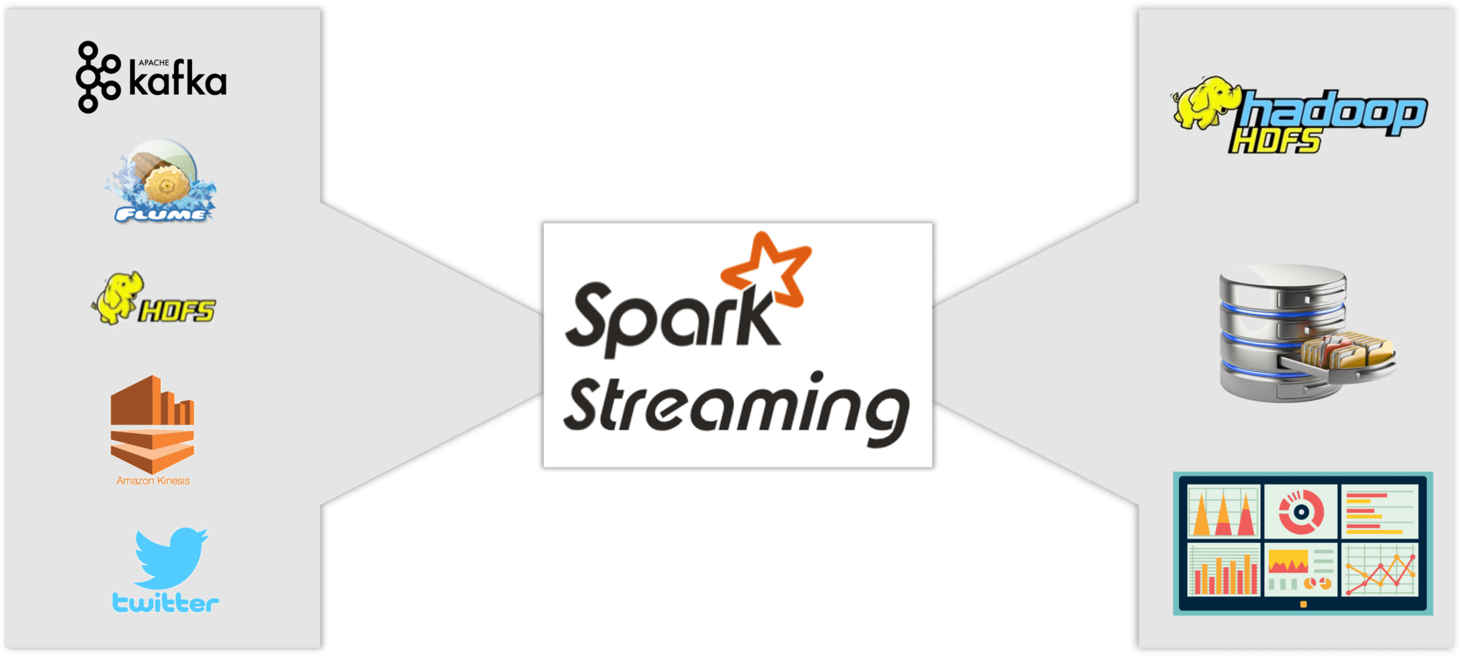

Slide 4
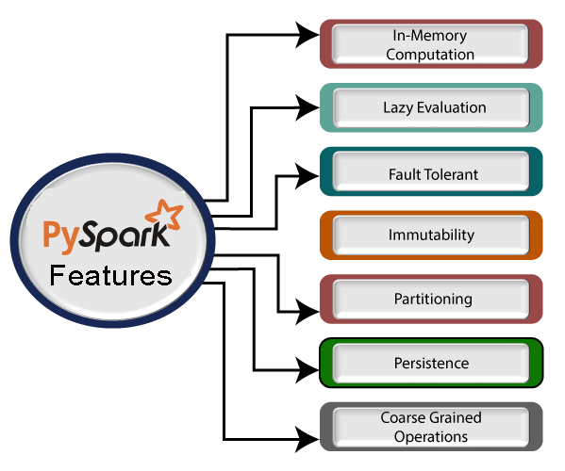

Slide 5
Languages
Apache Spark
Spark Core API
Streaming
GraphX
R, SQL, Python, Java, Scala
MLIib
SQL

Slide 6
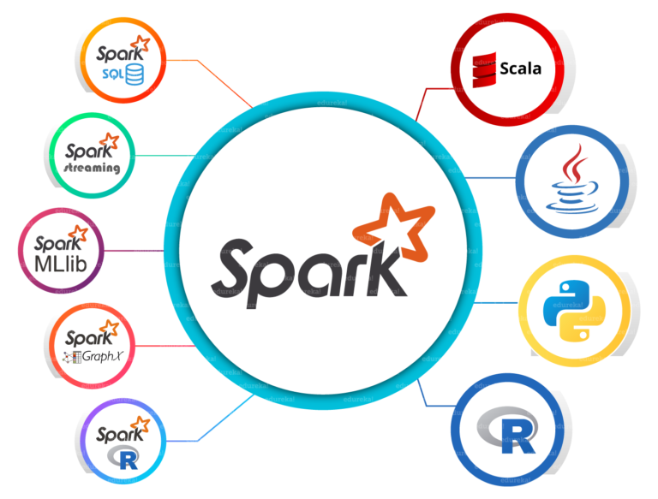

Slide 7
By default spark doesn’t have any memory computation.

Slide 8
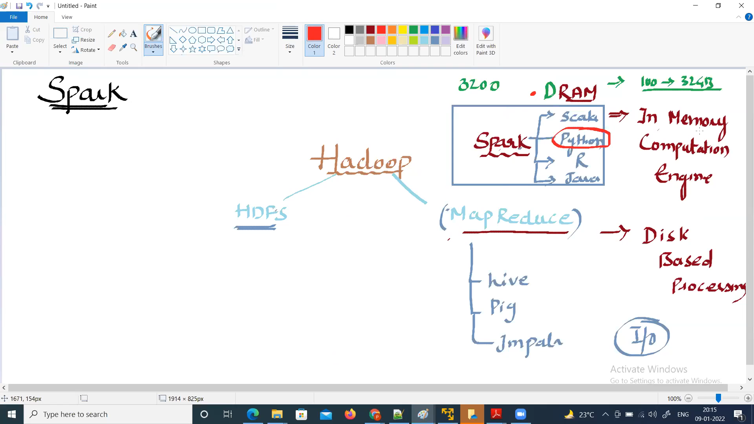

Slide 9
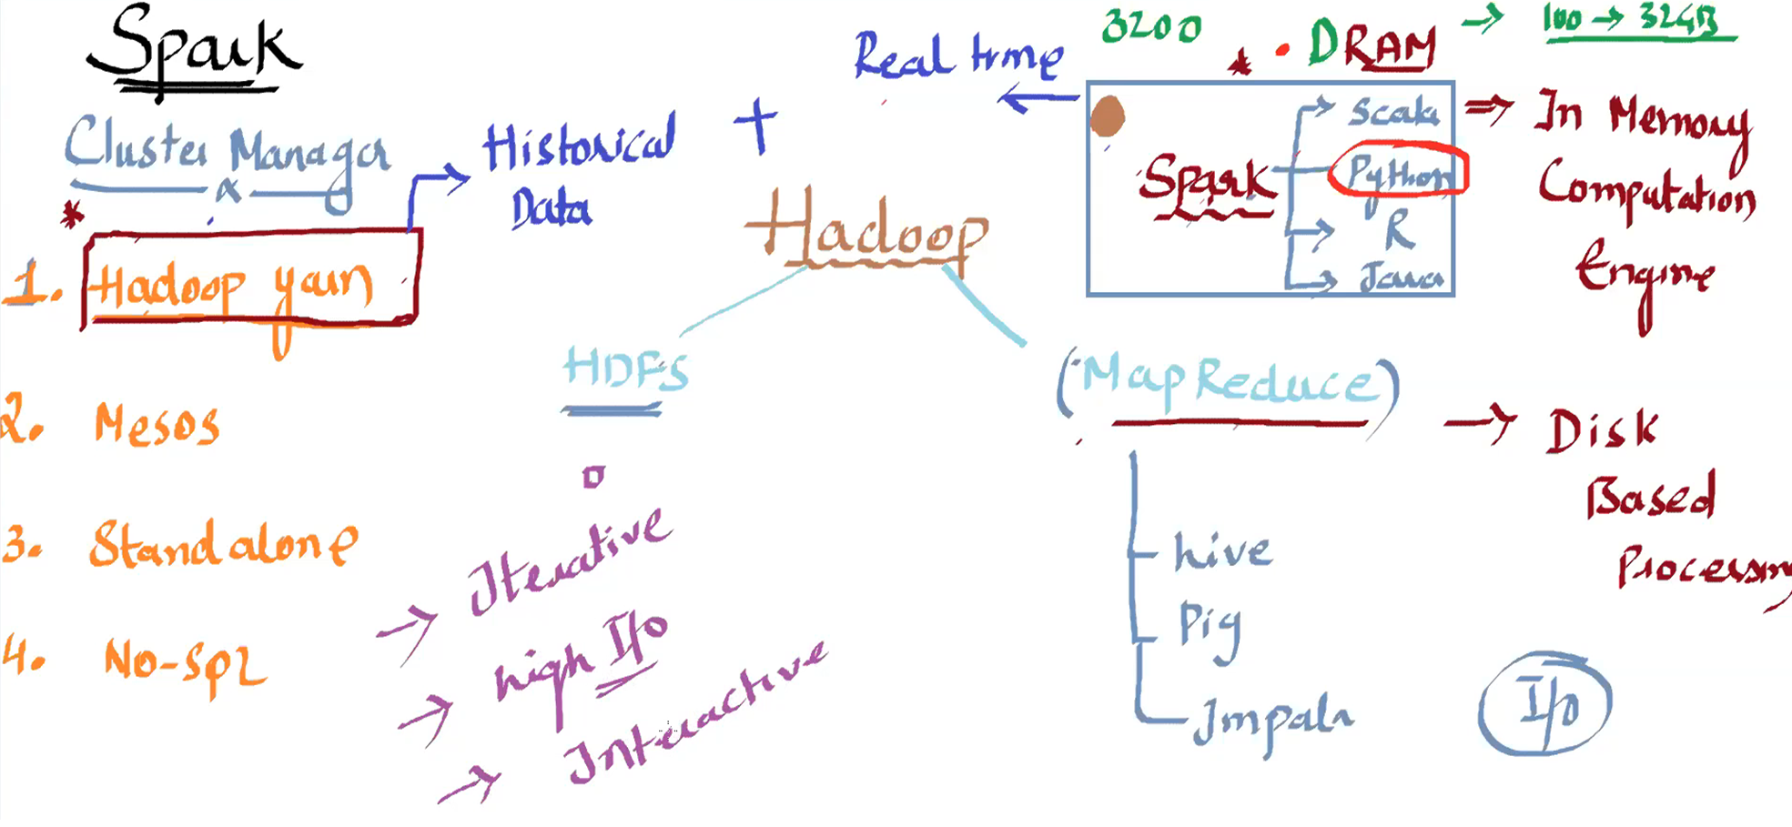

Slide 10
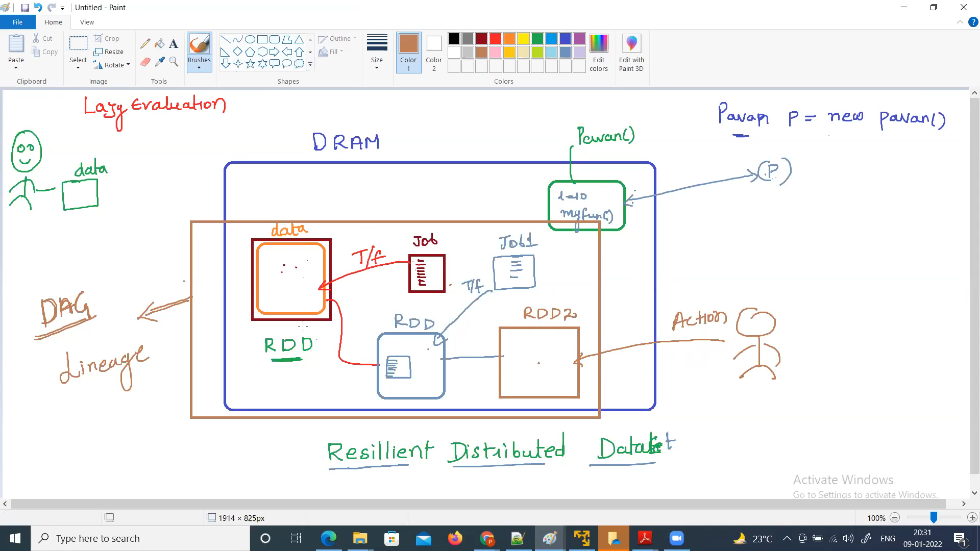

Slide 11
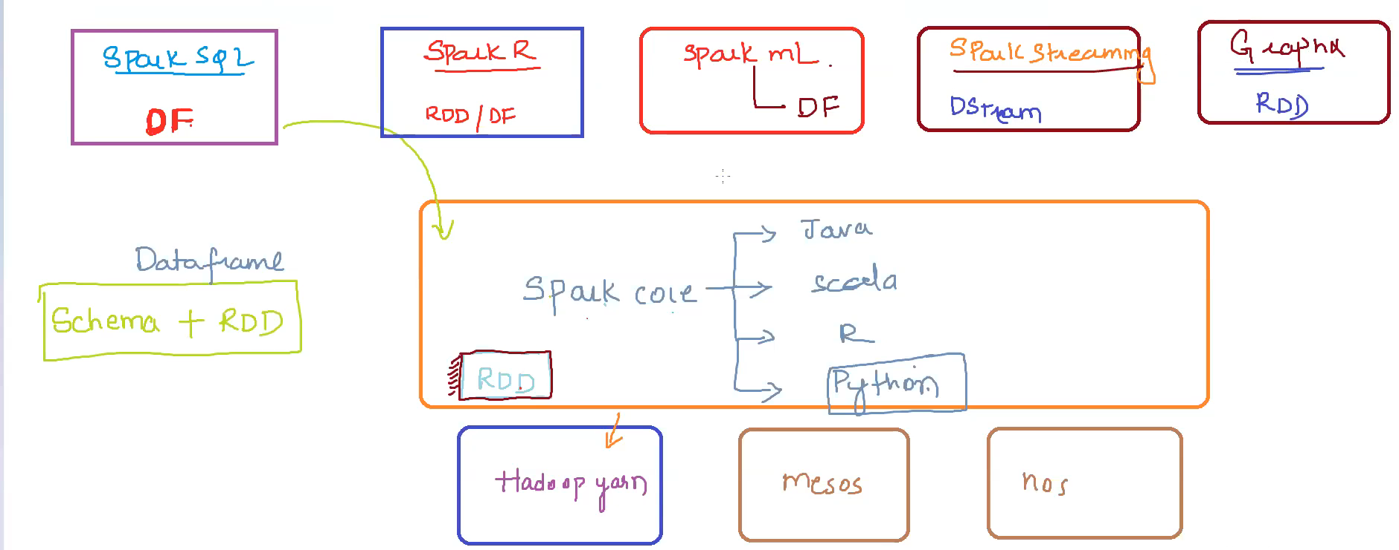

Slide 12
Spark Core
The underlying engine
Spark SQL
For SQL and unstructured data processing
Spark Streaming
Stream processing of the live data streams
MLIib
Machine Leaming algorithms
GraphX
Graph processing

Slide 13
Spark Core
The base of the Spark engine
Contains the basic functionalities of Spark, including task scheduling, memory management, fault recovery, etc,
The main programming abstraction for Spark Core is RDD which is its basic data ab5traction
Spark Core provides many APIs for processing Structured/unstructured data

Slide 14
Spark SQL
Spark SQL provides integrated APIs to work with structured data
It has a great set Of APIs for people coming from a SQL background as it allows querying data via SQL commands
It supports various data sources like CSV, JSON, Parquet, Hive. Cassandra, etc.

Slide 15
Spark Streaming
Spark Streaming enables the processing of live streams of data
It divides the live input data streams into batches
Por instance, lags being generated from an app server or live tweets from Twitter can be processed in near real time using Spark Streaming APIs

Slide 16
Spark MLlib
Machine Leaming and Al are significantly on hype these days
Spark MLIib provides in-built libraries to implement Machine Leaming algorithms
These Machine Learning algorithms include classification, regression, clustering, collaborative filtering, etc.
MLIib also provides various techniques for data preprocessing

Slide 17
Spark Graph
GraphX is a library for manipulating graphs
It provides analysis and graph computation for big data
GraphX cornes with a variety of graph algorithms and graph computations
It can be used for the disaster detection system, page ranking, financial fraud detection, etc.

Slide 18
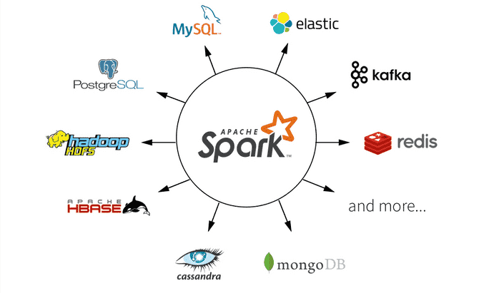

Slide 19
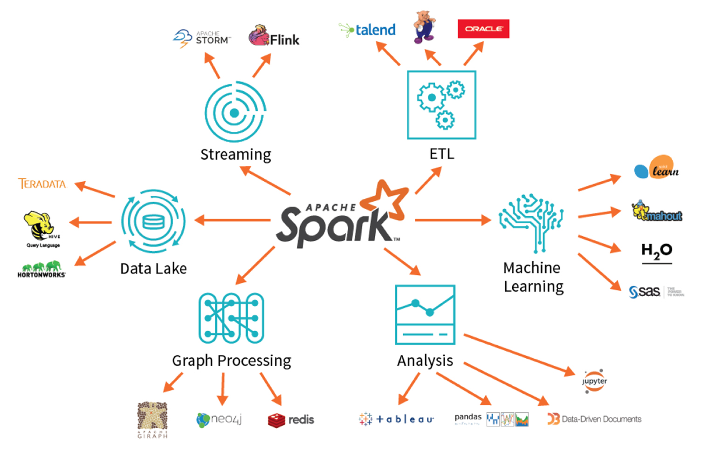

Slide 20
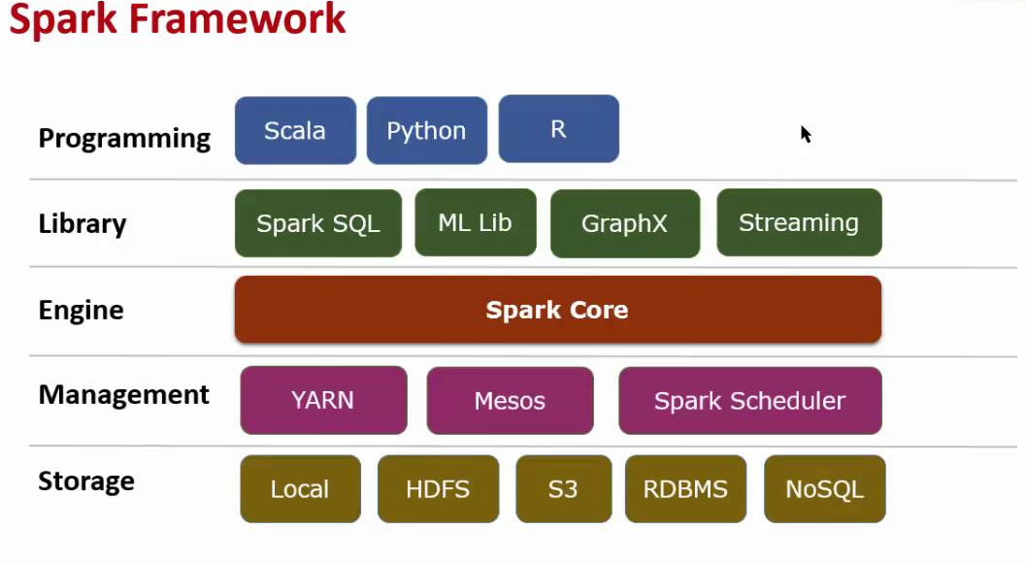

Slide 21
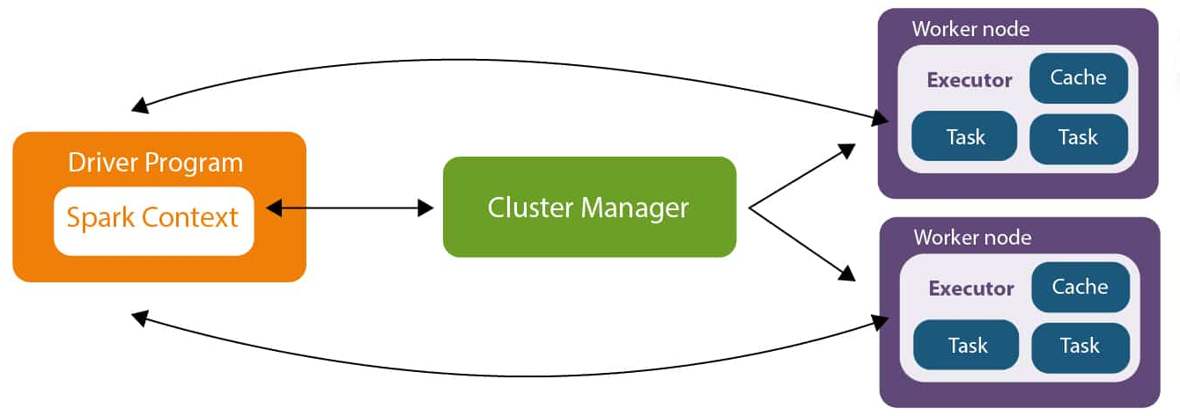

Slide 22
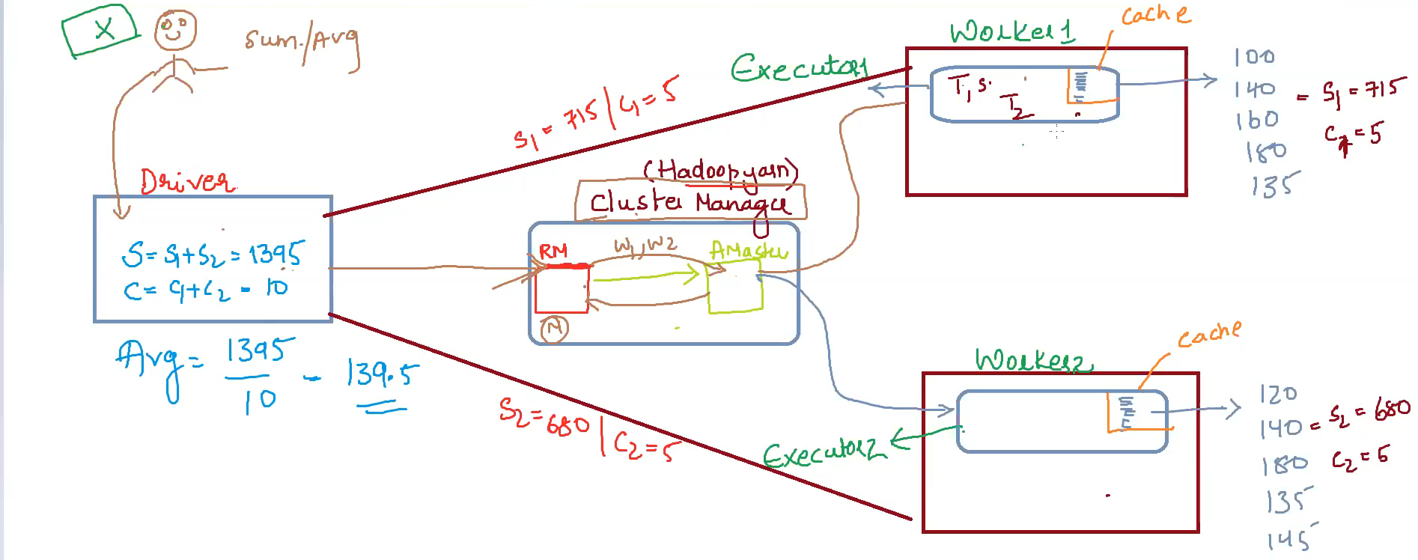

Slide 23
• Apache Spark provides a well-defined layered architecture All Spark components and lavers Are loosely coupled
• A driver program runs on the master node of the Spark cluster
• It schedules the job execution and negotiates with cluster
• It also translates RDDs into the execution graphs The driver program can split graphs into multiple stages

Slide 24
The Role of Cluster Manager in Spark
It is an external service possible for acquiring resources on the Spark cluster and allocating them to a Spark job.
Choosing a cluster manager for any Spark application depends on the goals of the application.
The standalone cluster manager is the easiest one to use when developing a new Spark application.

Slide 25
Spark Deployment Modes
Spark Standalone: We can launch a standalone Spark a third-party cluster manager. This cluster can be used for deploying Spark applicators
Spark on Apache Mesos: We Can deploy a Cluster using Apache Mesos, When Mesos, the Mesos master replaces the Spark master as tie cluster manager
Amazon EC2: We can launch a cluster on Amazon EC2 in about S minutes and it accelerates the speed with which Spark works
Kubernetes: We can deploy Spark on top of Kubernetes. Spark can leverage the power Of Kubernetes scheduler for faster
Spark on Hadoop YARN: We can deploy Spark on top Hadoop YARN, Spark leveraged with Hadoop can enhance the processing capabilities of Spark.

Slide 26
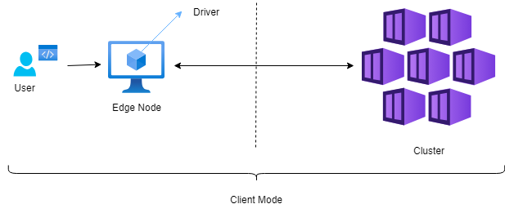
Running spark Applications on YARN
Apache Spark provides powerful distributed computing capabilities for processing large-scale data. When deploying Spark applications, it's essential to understand the deployment modes available: client mode and cluster mode. Each mode has its advantages and disadvantages, which we'll explore in detail below.
Client Mode
In client mode, the driver program runs on the client machine (Edge Node) where the application is submitted. This means the client machine initiates the SparkContext and submits tasks to the Spark cluster for execution.

Slide 27
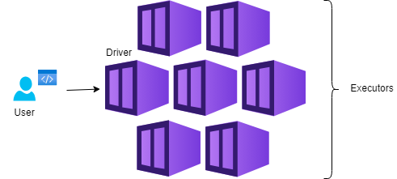
Cluster Mode
In cluster mode, the driver program runs within the Spark cluster, typically on one of the cluster's worker nodes. The client submits the application to the cluster manager, which then launches the driver program within the allocated resources.

Slide 28
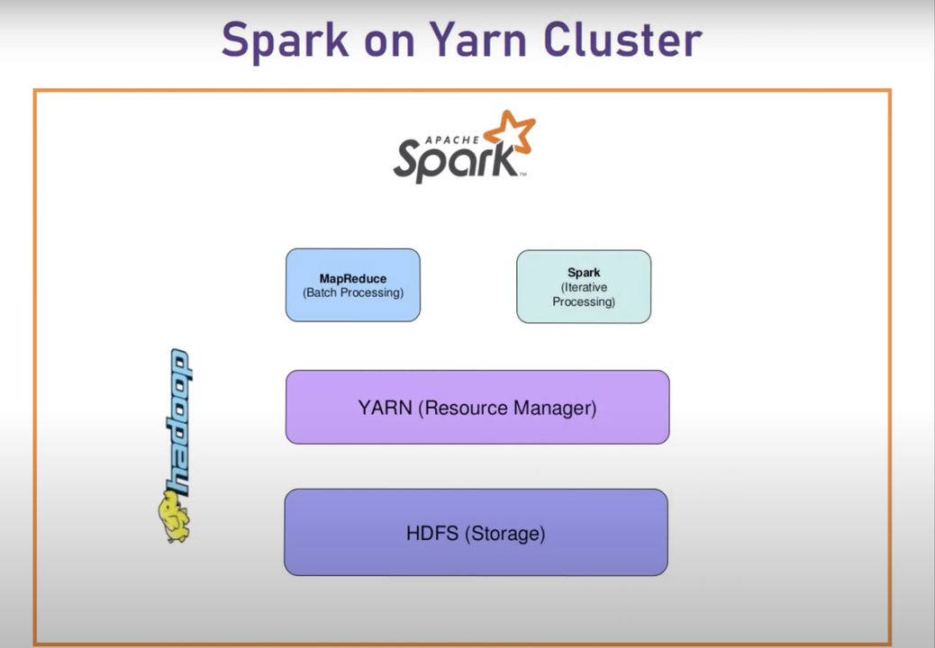

Slide 29
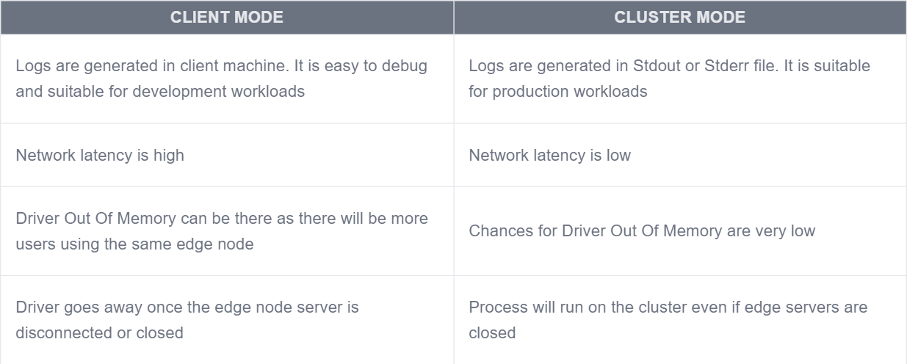
Client Mode vs Cluster Mode

Slide 30
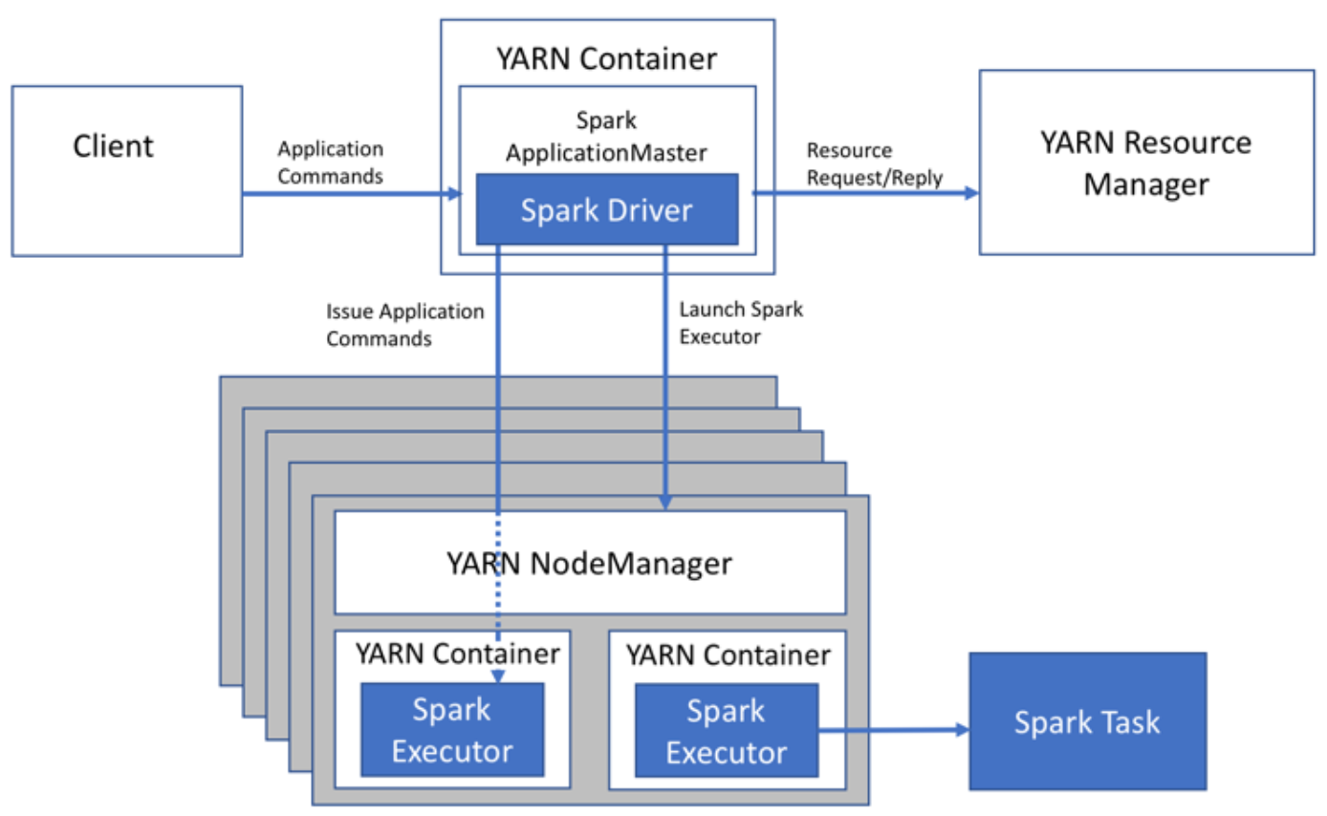
cluster deployment mode

Slide 31
Spark shell
PySpark shell support python.
Spark with Scala support Scala.
Spark with R support R.

Slide 32
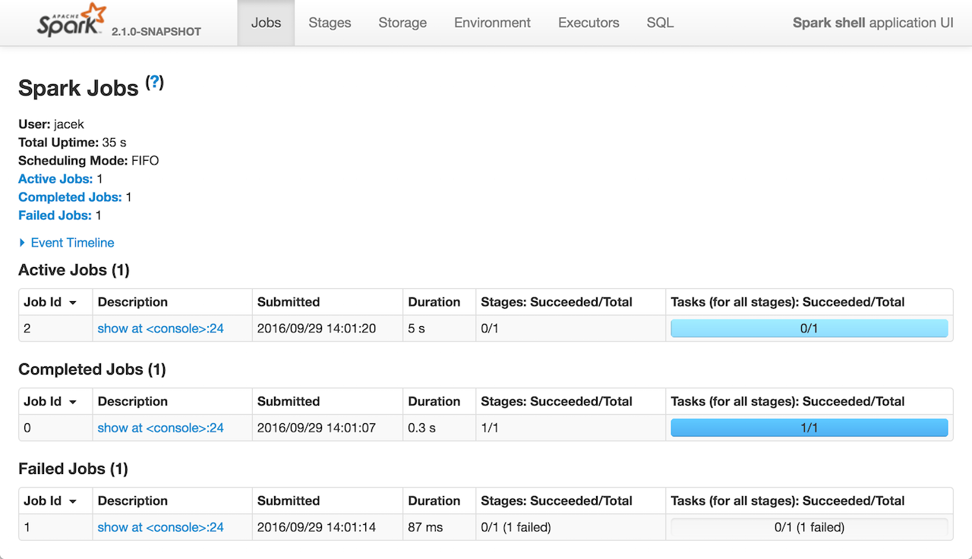
Spark Web UI Tabs:
Spark web UI
Spark jobs
Stages
Tasks
Storage
Environment
Executors
SQL
Structured Streaming
Streaming(DStreams)
JDBC/ODBC

Slide 33
Spark Web UI Job Tabs:
Spark web UI
Spark jobs
Stages
Tasks
Storage
Environment
Executors
SQL
Structured Streaming
Streaming(DStreams)
JDBC/ODBC
Jobs detail
This page displays the details of a specific job identified by its job ID.
Job Status: (running, succeeded, failed)
Number of stages per status (active, pending, completed, skipped, failed)
Associated SQL Query: Link to the sql tab for this job
Event timeline: Displays in chronological order the events related to the executors (added, removed) and the stages of the job.
Job tab consists Two pages.
1. All jobs
2. Details for job

Slide 34
Spark Web UI Stages Tabs:
Spark web UI
Spark jobs
Stages
Tasks
Storage
Environment
Executors
SQL
Structured Streaming
Streaming(DStreams)
JDBC/ODBC
The Stages tab displays a summary page that shows the current state of all stages of all jobs in the Spark application.
At the beginning of the page is the summary with the count of all stages by status (active, pending, completed, skipped, and failed.
Stages are includes
1. All stages
2. Stage Page
3. Pool Stage

Slide 35
Spark Web UI Tasks Tabs:
Spark web UI
Spark jobs
Stages
Tasks
Storage
Environment
Executors
SQL
Structured Streaming
Streaming(DStreams)
JDBC/ODBC
Tasks are located at the bottom space in the respective stage. Key things to look task page are: 1. Input Size – Input for the Stage 2. Shuffle Write-Output is the stage written.

Slide 36
Spark Web UI Storage Tabs:
Spark web UI
Spark jobs
Stages
Tasks
Storage
Environment
Executors
SQL
Structured Streaming
Streaming(DStreams)
JDBC/ODBC
The Storage tab displays the persisted RDDs and DataFrames, if any, in the application. The summary page shows the storage levels, sizes and partitions of all RDDs, and the details page shows the sizes and using executors for all partitions in an RDD or DataFrame.
Storage tab incudes:
1. Storage Page
2. RDD Page

Slide 37
Spark Web UI Environment Tabs:
Spark web UI
Spark jobs
Stages
Tasks
Storage
Environment
Executors
SQL
Structured Streaming
Streaming(DStreams)
JDBC/ODBC
The Environment tab displays the values for the different environment and configuration variables, including JVM, Spark, and system properties.
1. Runtime Information: simply contains the runtime properties like versions of Java and Scala.
2. Spark Properties: lists the application properties like ‘spark.app.name’ and ‘spark.driver.memory’.
3. Hadoop Properties: displays properties relative to Hadoop and YARN. Note: Properties like ‘spark.hadoop’ are shown not in this part but in ‘Spark Properties’.
4. System Properties: shows more details about the JVM.
5. Classpath Entries: lists the classes loaded from different sources, which is very useful to resolve class conflicts.

Slide 38
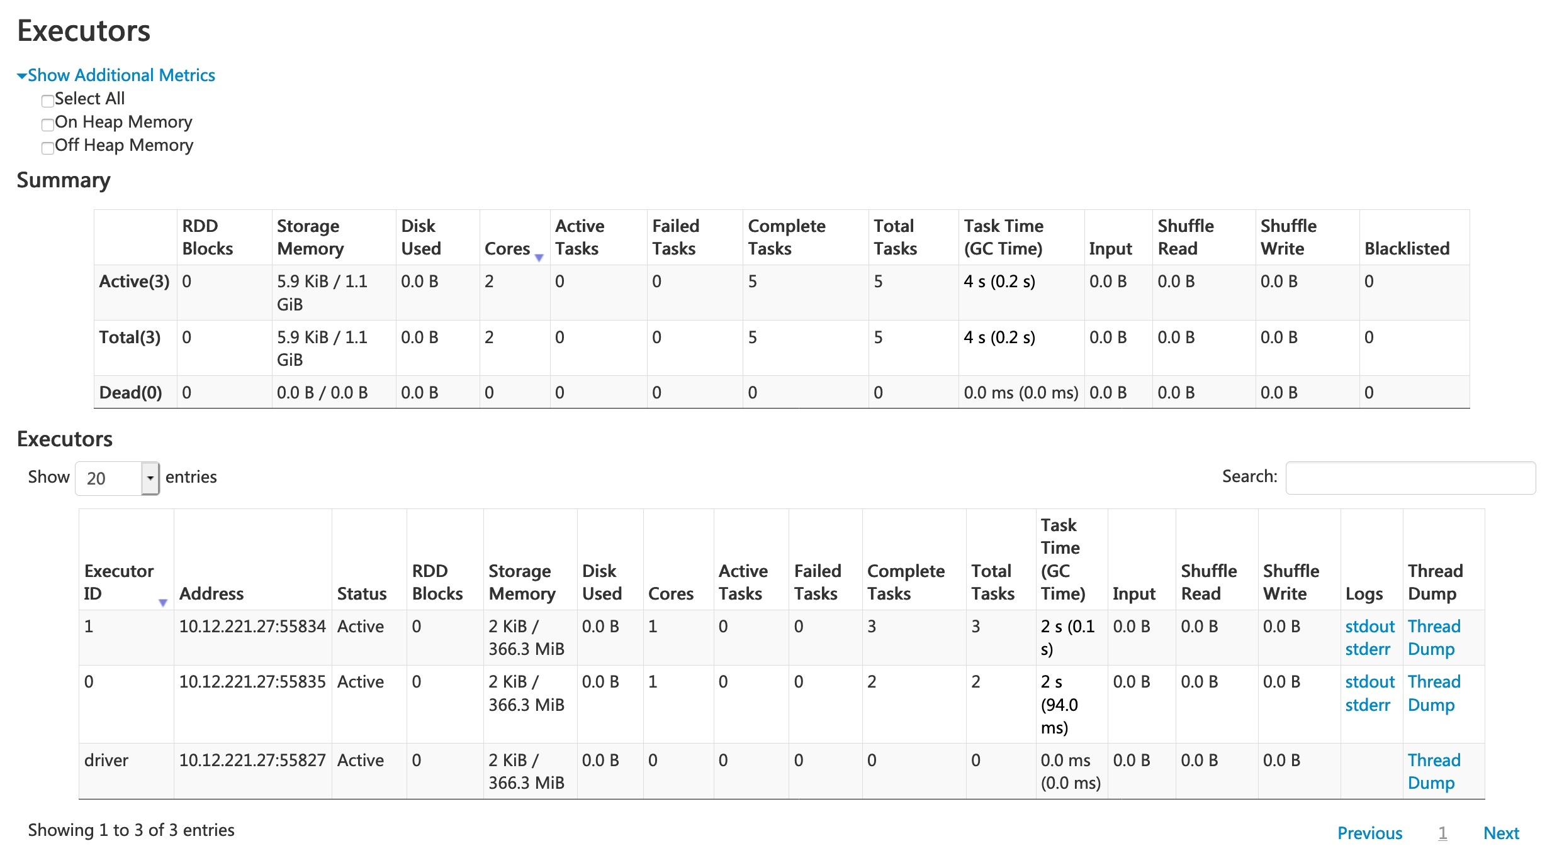
Spark Web UI Executors Tabs:
Spark web UI
Spark jobs
Stages
Tasks
Storage
Environment
Executors
SQL
Structured Streaming
Streaming(DStreams)
JDBC/ODBC
The Executors tab displays summary information about the executors that were created for the application, including memory and disk usage and task and shuffle information. The Storage Memory column shows the amount of memory used and reserved for caching data.

Slide 39
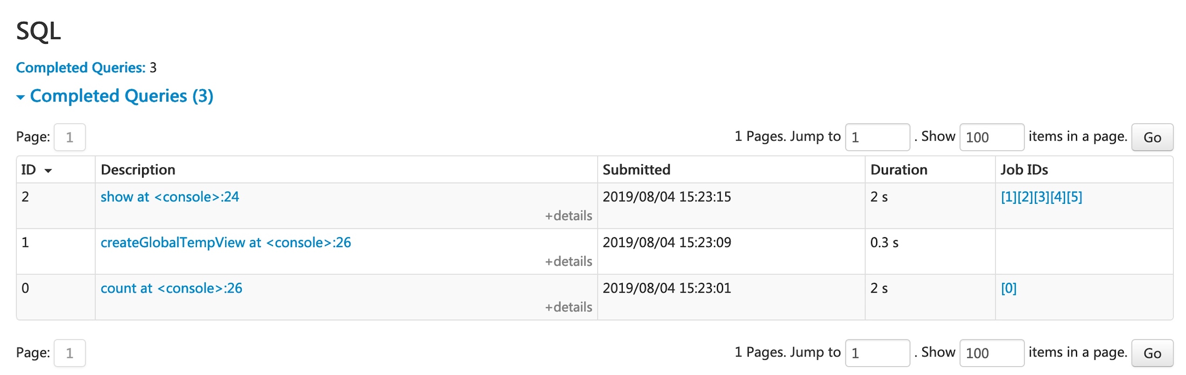
Spark Web UI SQL Tabs:
Spark web UI
Spark jobs
Stages
Tasks
Storage
Environment
Executors
SQL
Structured Streaming
Streaming(DStreams)
JDBC/ODBC
If the application executes Spark SQL queries, the SQL tab displays information, such as the duration, jobs, and physical and logical plans for the queries. Here we include a basic example to illustrate this tab.

Slide 40
Spark Web UI Structured Streaming Tabs:
Spark web UI
Spark jobs
Stages
Tasks
Storage
Environment
Executors
SQL
Structured Streaming
Streaming(DStreams)
JDBC/ODBC
When running Structured Streaming jobs in micro-batch mode, a Structured Streaming tab will be available on the Web UI. The overview page displays some brief statistics for running and completed queries. Also, you can check the latest exception of a failed query. For detailed statistics, please click a “run id” in the tables.
The statistics page displays some useful metrics for insight into the status of your streaming queries. Currently, it contains the following metrics.
Input Rate. The aggregate (across all sources) rate of data arriving.
Process Rate. The aggregate (across all sources) rate at which Spark is processing data.
Input Rows. The aggregate (across all sources) number of records processed in a trigger.
Batch Duration. The process duration of each batch.
Operation Duration. The amount of time taken to perform various operations in milliseconds. The tracked operations are listed as follows.
addBatch: Time taken to read the micro-batch’s input data from the sources, process it, and write the batch’s output to the sink. This should take the bulk of the micro-batch’s time.
getBatch: Time taken to prepare the logical query to read the input of the current micro-batch from the sources.
latestOffset & getOffset: Time taken to query the maximum available offset for this source.
queryPlanning: Time taken to generates the execution plan.
walCommit: Time taken to write the offsets to the metadata log.
Global Watermark Gap. The gap between batch timestamp and global watermark for the batch.
Aggregated Number Of Total State Rows. The aggregated number of total state rows.
Aggregated Number Of Updated State Rows. The aggregated number of updated state rows.
Aggregated State Memory Used In Bytes. The aggregated state memory used in bytes.
Aggregated Number Of State Rows Dropped By Watermark. The aggregated number of state rows dropped by watermark.

Slide 41
Spark Web UI Streaming(DStreams) Tabs:
Spark web UI
Spark jobs
Stages
Tasks
Storage
Environment
Executors
SQL
Structured Streaming
Streaming(DStreams)
JDBC/ODBC
The web UI includes a Streaming tab if the application uses Spark Streaming with DStreams API. This tab displays scheduling delay and processing time for each micro-batch in the data stream, which can be useful for troubleshooting the streaming application.

Slide 42
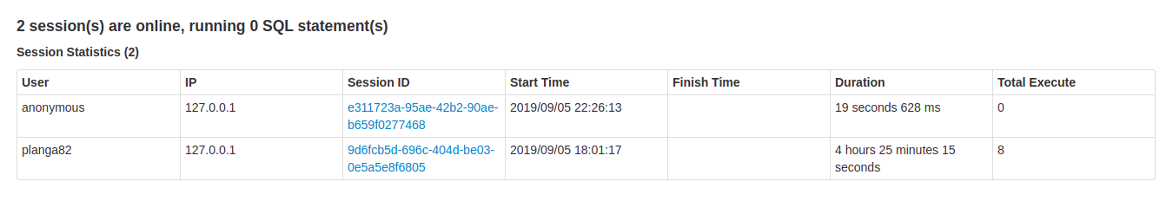
Spark Web UI JDBC/ODBC Tabs:
Spark web UI
Spark jobs
Stages
Tasks
Storage
Environment
Executors
SQL
Structured Streaming
Streaming(DStreams)
JDBC/ODBC
We can see this tab when Spark is running as a distributed SQL engine. It shows information about sessions and submitted SQL operations.
The first section of the page displays general information about the JDBC/ODBC server: start time and uptime.

Slide 43
PySpark Shell
PySpark shell is referred as REPL (Read Eval Print Loop) which is used to quickly test PySpark statements. Spark shell is available for Scala, Python and R (Java might be supported in previous versions). The PySpark command is used to launch Spark with Python shell also call PySpark. Use spark-shell command to work Spark with Scala. The spark command is used to launch Spark with R language. PySpark shell default provides spark and SC variables. spark is an object of SparkSession and SC is an object of SparkContext. In PySpark shell, you cannot create your own SparkContext.

Slide 44
Submitting a PySpark job
Many times our code depends on other projects or source codes, So we need to package them alongside our application to distribute the code to a Spark cluster
For this, we create an assembly jar containing our code and its dependencies
Both SBT and Maven have assembly plugins
When creating assembly jars, list Spark and Hadoop as provided dependencies
Once we have an assembled jar, we can call the bin/spark-submit script while passing our jar
The spark-submit script is used to launch applications on the cluster

Slide 45
Submitting a PySpark job
Spark is preconfigured for YARN, and it does not require any additional configuration to run
YARN controls resource management, scheduling, and security when we run Spark applications on it
It is possible to run an application in any mode, whether it is cluster mode or client mode
Launching a Spark application in the Cluster/Client mode:
$ ./bin/spark-submit \
--class org.apache.spark.examples.SparkPi \
--master yarn \
--deploy-mode cluster \
--driver-memory 4g \
--executor-memory 2g \
--executor-cores 1 \
--queue thequeue \
examples/jars/spark-examples'. jar \

Slide 46
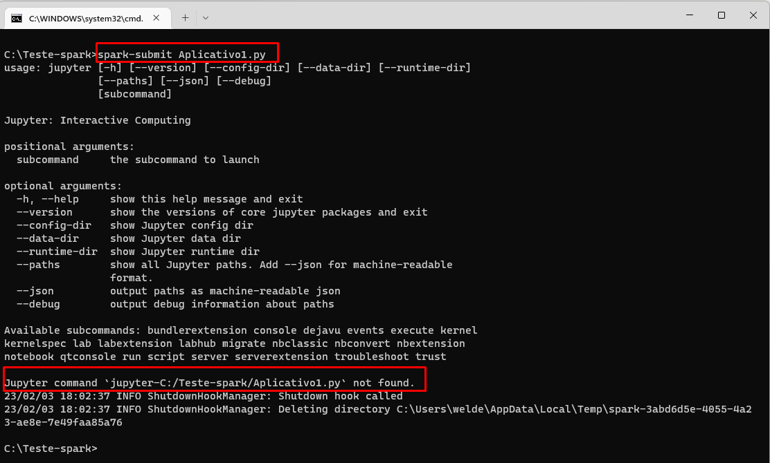
Submitting a PySpark job
Launching Spark on YARN
$ ./bin/spark-submit --class path.to.your.Class --master yarn --deploy-mode cluster [options] <app jar> [app options]

Slide 47
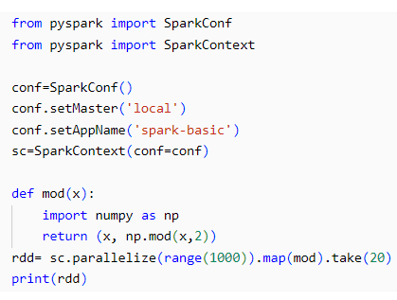
The First Pyspark Job
Spark can easily run a Spark standalone job
This example runs a minimal Spark script
It includes:
Importing PySpark
Initializing a SparkContext
Performing a distributed calculation on a Spark cluster in the standalone mode
Defining a method 'mod' to perform an action in Spark Job
Using an RDD operation to perform a transformation

Slide 48
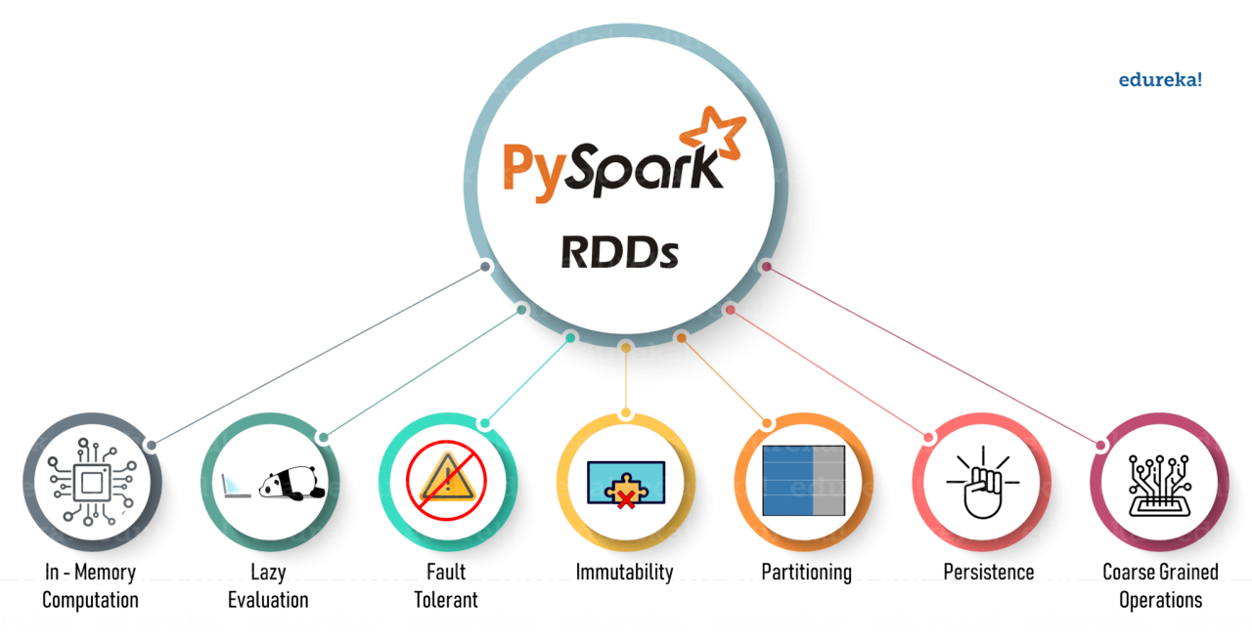



Slide 49
Spark RDDs
RDDs are the ruin logical data in Spark
They are a distributed collection Of objects, stored in memory or On disks of different machines Of a cluster
A single RDD can be divided into multiple logical partitions so that these partitions can be stored processed on different machines Of a cluster
RDDs in Spark can be cached and used again for future transformations They are lazily evaluated. i.e., Spark delays the RDD evaluation until it is really needed
We Can perform and actions on RDDS

Slide 50
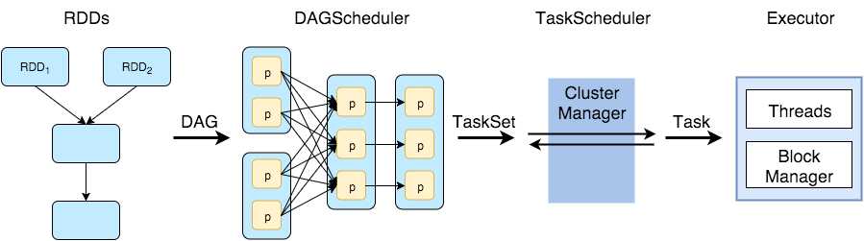
RDD workflow

Slide 51
Ways to Create RDDs in PySpark
Create rdd from a collection object {set, list, dict, tuple, arrays}
Create an rdd from an existing rdd(Transformation)
Create rdd from external data sources.

Slide 52
Thank You
Q&A

